Slide 1

Overview of Word Processing and MS Word
CSE-100
Basic Computing
Department of Computer Science and Engineering Bangladesh University of Engineering and Technology
Dhaka, Bangladesh

Slide 2
Introduction to Word Processing
Word processing means using IT to produce text.
There are many advantages of word processing such as
    users can easily make changes in documents
    user can easily find a word from a large document
    user can easily replace any word in a document
    printing many copies is also easy
Word Processing software is used to create and print documents

Slide 3
Introduction to MS Word
MS Word is a word processing software
It is a product of Microsoft Corporation
It is very easy and convenient to use
Any kind of documents can be prepared by using MS Word
Examples: documents with only text, documents with text and image etc.

Slide 4
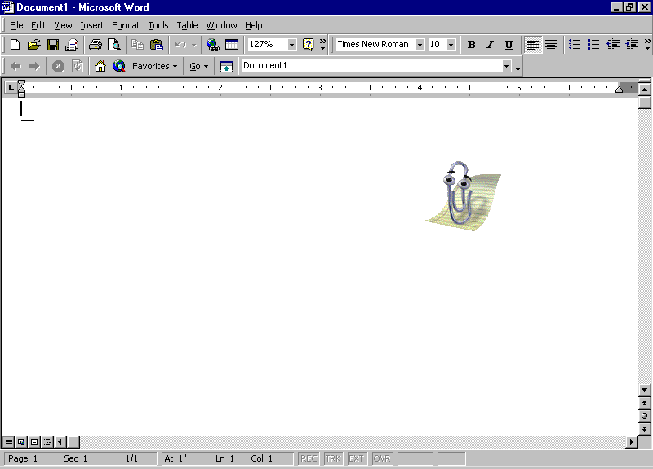
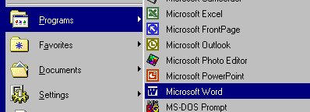
How to Open MS Word
Click the Start
Go to Programs or All Programs and then select Microsoft word

Slide 5

MS Word Menu Bar and Drop Down Menus
Drop down menu options include:
  File Edit View Insert
  Format Tools Table Window
  Help

Slide 6
MS Word Toolbars
Toolbars contain small pictures called tool icons
  When clicked they provide a shortcut method of performing a Word action
The toolbars that are displayed on your system are controlled via the Toolbars command, located under the View drop down menu
TIP:
Right clicking on any MS Word toolbar displays the Toolbar list

Slide 7
Working with files
Create a new file
Enter text into a file
Moving through a word document
Saving a file
  Using Security Options tool
Opening a saved file
Closing files

Slide 8
Editing Commands
Selecting and deselecting text
Deleting text using clear
Moving text using cut and paste
Duplicating text using copy and paste
Finding text
Replacing text

Slide 9
Viewing Options
Document Layout
  Print Layout
  Normal Layout
  Web Layout
  Reading Layout
  Outline
Document Map
Header and Footer
Toolbars and Panes

Slide 10
Inserting Options
Break
Page Numbers
Date and Time
Auto text
Symbols
Picture
    Images, Charts, Diagrams, Word Art …
    Using the Drawing toolbar
Other files / Objects

Slide 11
Formatting Options
Font formatting
  Type, Style, Size, Color, Special Effects
Paragraph formatting
  Indent and Spacing
  Line and Page Breaks
Adding Bullet and Numbering
Using Borders and Shading
Changing background, themes
Using Styles and formatting
Picture/ drawings formatting

Slide 12
Formatting Options (2)
Page formatting
  Margins
  Orientation
  Paper size
  Position
  Layout
  Line Numbering

Slide 13
Working with tables
Insert
  Tables, Columns, Rows, Cells
Delete
  Tables, Columns, Rows, Cells
Merge
  Rows, Columns, Cells
Split
  Rows, Columns, Cells
Format
  Tables, Rows, Columns, Cells

Slide 14
Working with tools
Checking Spelling and Grammar
Counting Words
Proof Reading
Customizing Toolbars and Menus
Setting General Options
Advanced Tools
  Using Mail Merge
  Using Macros
  Using Protection

Slide 15
Windowing options
Split window
Opening in a new window
Compare windows side by side
Arrange all documents

Slide 16
Printing Documents
Page Setup
  Margins
  Orientation
  Paper size
  Position
  Layout
  Line Numbering
Print Preview
Printer Setup

Slide 17
Question ?

